Slide 1

Building Modern Mobile Apps
Xamarin
Brent Edwards
Principal Lead Consultant
Magenic
Level: Intermediate, etc.

Slide 2
Brent Edwards
BrentE@magenic.com
@brentledwards
http://www.brentedwards.net
https://github.com/brentedwards

Slide 3
Mobile Tasks Source Code
Github
https://github.com/brentedwards/MobileTasks

Slide 4
What is Xamarin?

Slide 5
What is Xamarin?
Build Native Apps with Visual Studio and C#

Slide 6
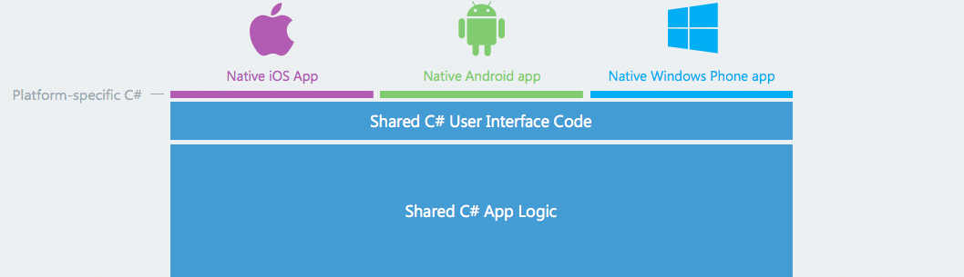
What is Xamarin?
https://www.xamarin.com/platform

Slide 7
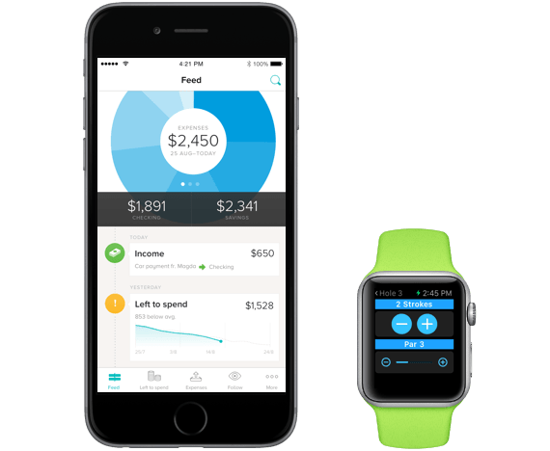
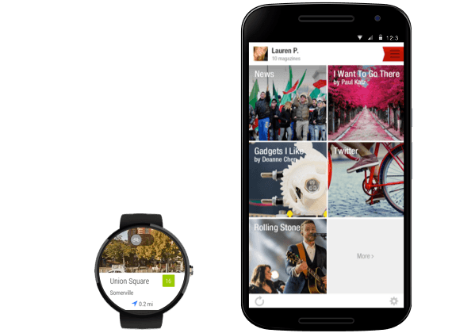
What is Xamarin?
https://www.xamarin.com/platform

Slide 8
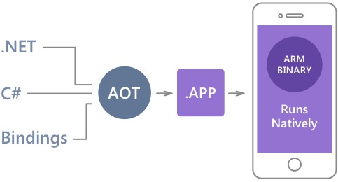
Native Performance
Xamarin.iOS does full Ahead Of Time (AOT) compilation to produce an ARM binary for Apple’s App Store.
Xamarin.Android takes advantage of Just In Time (JIT) compilation on the Android device.

Slide 9
History
Began with Mono
Open source project port of .NET to multiple platforms
Xamarin founded in 2011
Support Mono project
Develop commercial tools leveraging Mono

Slide 10
Dev System requirements

Slide 11
Dev System Requirements
Xamarin.iOS
Mac (Required)
Windows PC (Optional)
XCode
Visual Studio 2012+
Xamarin Plugin
Still has to network with Mac
OS X Yosimite+
Xamarin Studio

Slide 12
Dev System Requirements
Xamarin.Android
Mac
Xamarin Studio
Windows PC
Visual Studio 2012+
Xamarin Plugin
Windows PC
Xamarin Studio
OS X Yosimite+

Slide 13
Testing
iOS Simulator
On Mac only
Android Emulator
Default Emulator
Genymotion Emulator
Visual Studio Emulator

Slide 14
Device Testing
Test on real devices too!
Emulators/Simulators are only an approximation
Real devices have different constraints and limitations
Test on multiple devices for each target platform

Slide 15
Building Apps

Slide 16
Building Apps
Some Questions
Are you targeting multiple platforms?
Are you hoping to re-use common code/logic?

Slide 17
Re-Using Code/Logic
Know difference between UI-specific code and common logic
UI-specific code interacts with UI elements
Common logic is agnostic of UI

Slide 18
Project Structure
UI-Specific projects for Android and iOS
UI-Agnostic project(s) for common logic
Consider separate solutions if Android and iOS devs are not same people

Slide 19
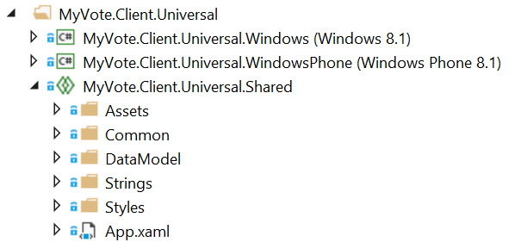
Universal Shared Projects
Essentially a code placeholder project
Does not compile on its own

Slide 20
Universal Shared Projects
Put common code in universal shared project
Platform-specific code in platform-specific projects
What is common?
Models
ViewModels
Converters
Services

Slide 21
What about Portable Class Library?
What is a PCL?
Single project that compiles for multiple platforms
Drawbacks
Lowest common denominator between platforms
Referenced assemblies must be PCL also

Slide 22
Universal Shared Projects
Included with VS 2015
For VS 2013
Shared Project Reference Manager
http://visualstudiogallery.msdn.microsoft.com/315c13a7-2787-4f57-bdf7-adae6ed54450

Slide 23
Project Structure
iOS
UI Code
Controllers
Android
UI Code
Activities
Core Library
Business Logic
Services
Data Access

Slide 24
Xamarin.Android

Slide 25
Xamarin.Android
Primary Components
Android Manifest
Resources
Layouts
Graphic Assets
String Values
Activities

Slide 26
Android Manifest
Defines Activities
We’ll come back to this
Requests Permissions
Internet access
GPS or network-based location
Camera

Slide 27
Layouts
File that defines the UI
Place views and controls
Assign IDs for Activities to find
Placed in Resources > layout folder
*.axml

Slide 28
Graphic Assets
Graphic files used by the UI
Placed in Resources > drawable
Can make density-specific folders

Slide 29
String Values
Define all strings shown in UI
Placed in Resources > values
Strings.xml
Easier for globalization

Slide 30
Activities
Interacts with the user interface
Respond to input
Drives the user experience
Responds to Lifecycle changes

Slide 31
Activities
Implementing an Activity
Decorate with Activity attribute
Signal for Android Manifest
Inherit from Activity class
Override OnCreate method
SetContentView
Wire up UI interactions

Slide 32
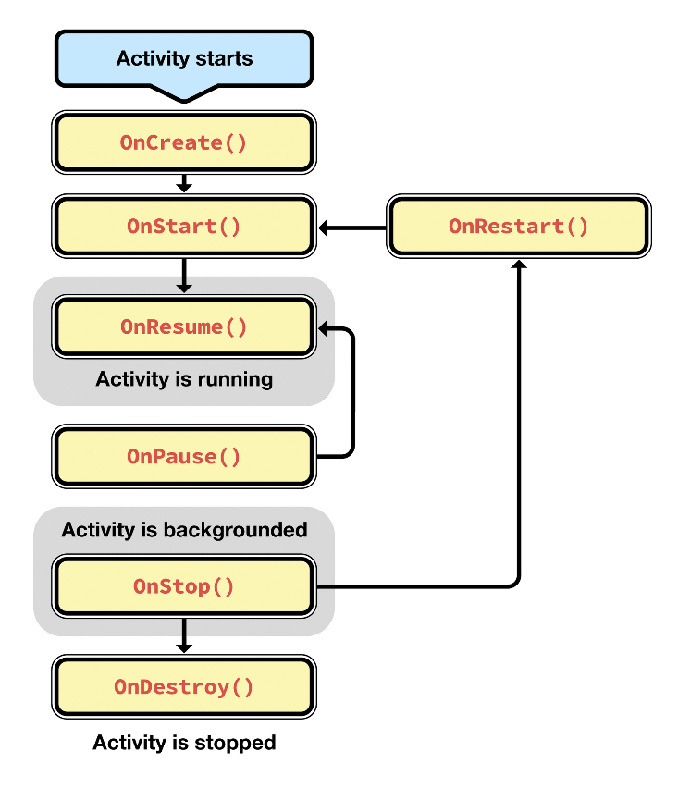
Activity Lifecycle
https://developer.xamarin.com/guides/android/application_fundamentals/activity_lifecycle/

Slide 33
Xamarin.Android
[DEMO]

Slide 34
Unit Tests
Create Xamarin.UITest project
Can run tests locally within Visual Studio
Then deploy to Xamarin Test Cloud

Slide 35
Continuous Integration
CI Build Servers can be configured for Xamarin
Install Visual Studio and Xamarin tools
iOS will require a Mac OS X machine for build server
This machine can create final app package

Slide 36
Strengths
Working with Visual Studio and C#
Native look-and-feel
Lots of code re-use

Slide 37
Weaknesses
Mac required (for iOS)
Connection can get flakey
Can’t re-use UI code

Slide 38
Conclusion
Xamarin is a solid choice
As close to native as C# gets
Worth checking out for C# shops

Slide 39
Questions?

